Slide 2
Chapter 1: Introduction
Part A: Core Concepts
Part B: The Practicalities
Rationale, Scope and Background of Cultural Risk Assessment and CIERA
Chapter 2:
Chapter 8:
Cultural Risk Assessment & The Cultural Inclusivity and Equity Risk Assessment (CIERA)
Chapter 3: Cultural Risk – EEDI and Bias
Activating Theory -
England and Wales Cricket Board
Chapter 9:
Chapter 4: The Science of Inclusion and Bias
Managing Organisational Risk: Integrating Cultural Risk Awareness into Corporate Governance
Chapter 10:
Chapter 5: Culture
Chapter 11:
Comparing faith in cultural contexts: In Sacred Spaces and on the Dancefloor
Chapter 6: Theories and Frameworks
Chapter 12:
Activating Theory - Action Research with Faith Leaders for the British Ritual Innovation in COVID
Chapter 7: Cultural Intelligence (CQ)
Chapter 13:
Between the lines -
Conversations in Context, a Dialogical Approach
Part C: Case Studies
CS 1: Sweden – Religious Heritage
CS 10: UK – Faith and Sexuality
CS 2: UK – Sensory Rooms
CS 6: Qatar – Football World Cup
CS 11: UK – Cultural Events
CS 3: England – Prom Events
CS 7: USA – NFL
CS 12: USA – Belonging and Ethnicity
CS 4: UAE – Cultural Awareness
CS 8: Japan – Cultural Heritage
CS 13: Caribbean – Diaspora Communities
CS 5: Australia – Indigenous Communities
CS 9: UK – Sport and Gender
CS 14: Nigeria – Business Events

Slide 3
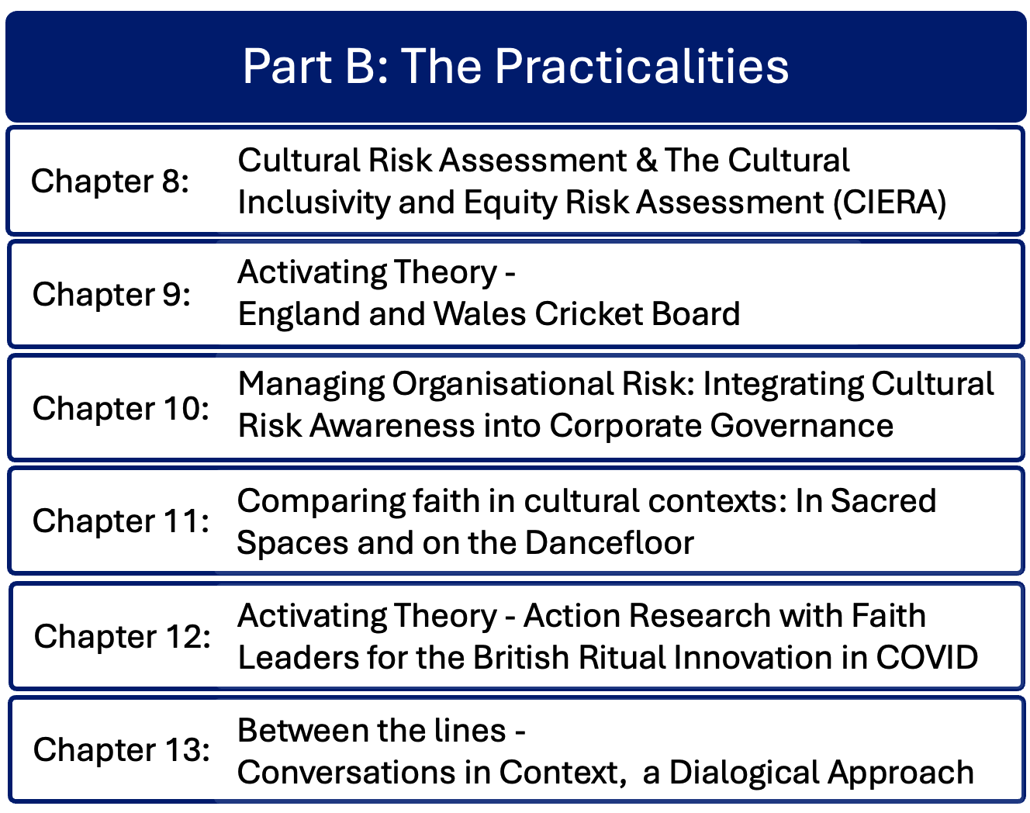

Slide 4
Chapter 8: The Cultural Risk Assessment and the Cultural Inclusivity and Equity Risk Assessment Bernadette Albert
Discusses the practicalities of cultural risk, offering examples and suggestions for gaining expertise.
Continues the story of developing the cultural risk assessment and the CIERA©.
Reflects on variations in culture and the need for cultural intelligence imperative to cater for variations in diverse contexts
Examines closely the details, structures and processes that comprise the CRA and CIERA©

Slide 5
Introduction – the Cultural Risk Assessment (CRA) and the Cultural Inclusivity and Equity Risk Assessment (CIERA©)
Event managers have moral, ethical and legal mandate to deliver inclusive event spaces
Therefore event managers need to understand how space impacts inclusion
This results in the need for event managers to develop Cultural Intelligence (CQ), which is used to inform assessment and mitigation of cultural risks

Slide 6
Origins of the CRA
CRA initially designed within module on culture and titular in events
Students and event managers need to develop cultural awareness, build individual cultural capital, and understand diversity and inclusive practice in order to create inclusive event spaces
Tools such as CRA and CIERA© enable analysis that facilitates delivery of culturally intelligent events, contributing to wider transformation across organisations, systems and social contexts

Slide 7
The Cultural Risk Assessment
First iteration was designed to build students’ competence and cultural awareness
Analysed key event features including catering, design, accessibility – reasonably easy to identify as visible elements of the cultural iceberg
Fashioned along the lines of Health and Safety Risk Assessment
Second iteration based on reigniting of broader issue across events sector and beyond, which lacked tools to support strategic EEDI implementation in events and event organisations
As a consequence, people working in the sector with diverse traits and characteristics would also benefit
CIERA© is an extension of CRA to assess institutional and physical environments

Slide 8
Requisite skills for delivery – CRA
CRA tool requires implementation by individuals with higher levels of cultural competence
CRA led to the development of the concept of cultural competence and the Cultural Intelligence Development Framework
Traditional Health and Safety Risk Assessment requires assessors to be ‘suitably and sufficiently qualified’
Assessing cultural risk requires specific cultural knowledge and ability to research cultural environments across all protected characteristics and beyond
Falassi’s (1967) typological model of ritual enhances identification of less tangible cultural elements

Slide 9
The CIERA©
Constructed on the basis that simply including representation of groups alone does not create diverse spaces
Authentic engagement regardless of diverse characteristics hinges in inclusion – more than representation
Accesses full range of positive attributes of diverse groups
Rationale – grounded in proactive legal compliance, risk mitigation, ethical values, organisational excellence
Requires extensive paper trail for tangible evidence
Supports benchmarking the existing context to identify areas for improvement
Organisational conflicts in multicultural environments arise from lack of cultural humility and awareness, cultural insensitivity and bias
Creates alignment with organisational moral and ethical values, moving beyond virtue signalling

Slide 10
Application of the CIERA©
The CIERA© process steps
CIERA© process encompasses the whole organisation, with cross-section of operations, people, space, place, systems, strategy and delivery
A living document
Identify the audience
Identify macro and micro cultural components
Identify the area of focus
a) Audit b) Classify existing characteristics
Identify impacts
a) Identify mitigative measures b) Implement mitigative measures
Evaluate and review

Slide 11
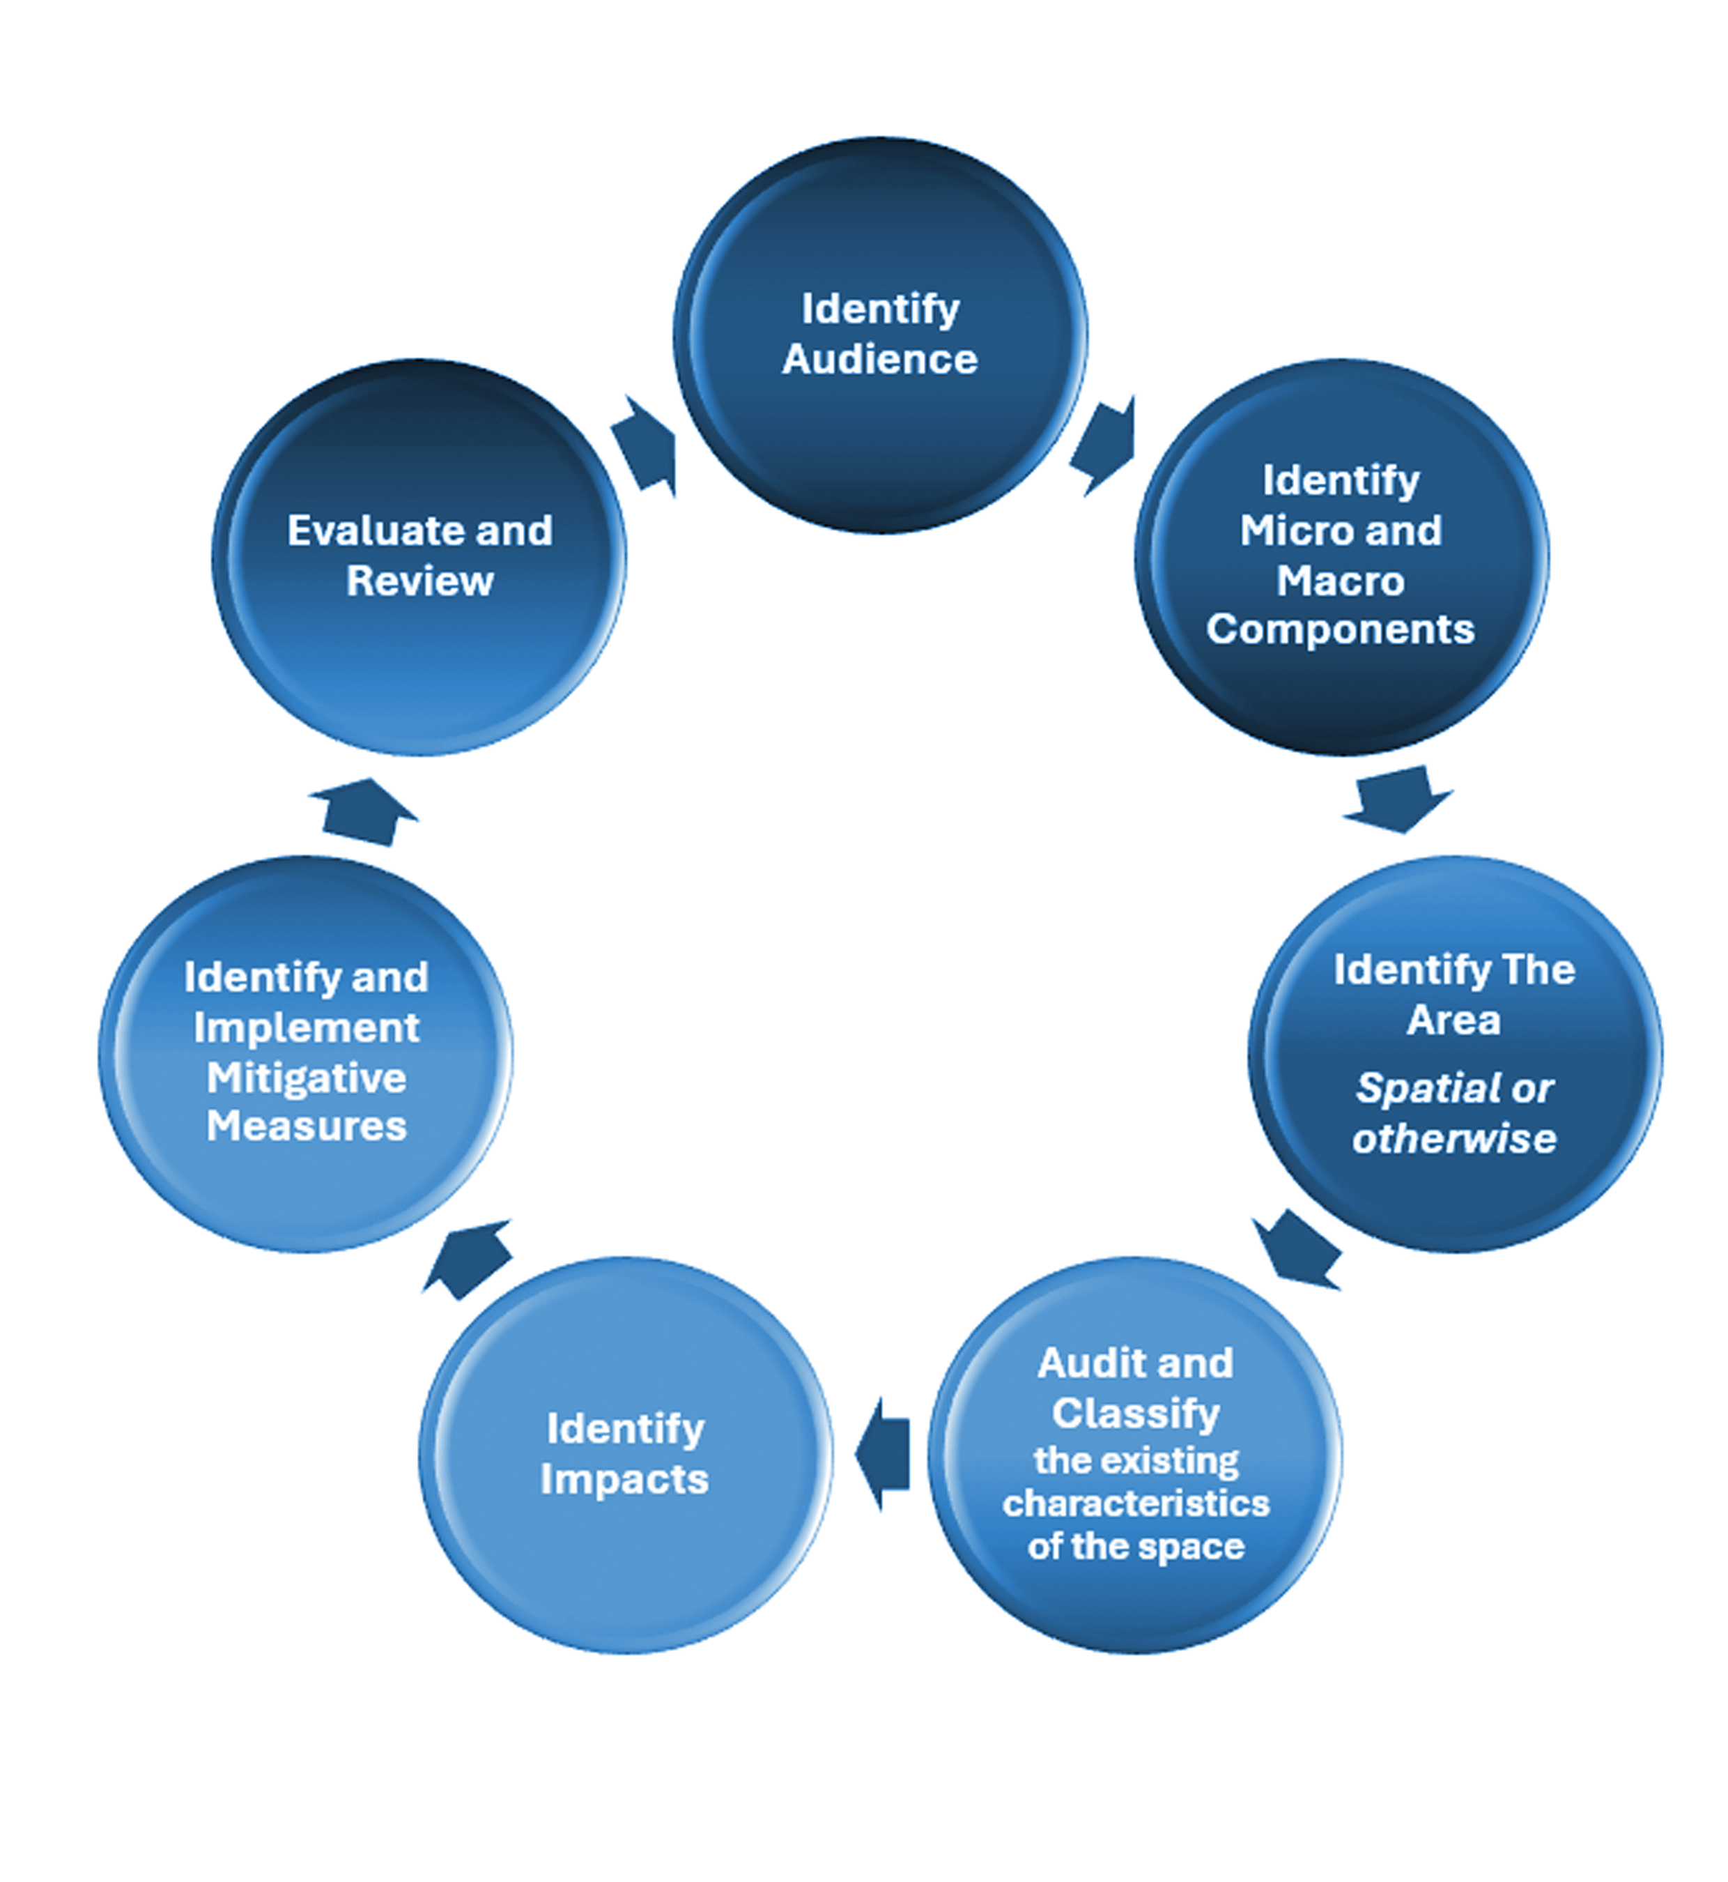
The CIERA© process

Slide 12
Key aspects of the CIERA©
Scope – context – assessment criteria of each unique context
Communication and consultation
Cultural identification – presence of diversity in the organisation; protected characteristics and impacts
Risk identification and analysis – Impacts: reputational, emotional, psychological, physical, wellbeing, motivational, business objectives, CSR
Recording and reporting
Monitoring and review

Slide 13
Summary
CRA and CIERA© contribute to tangible and actionable processes
Applicable across sectors (events and beyond) and to transformation of society
Contribute to sense of belonging

Slide 14
Discussion Questions
How would you utilise the CIERA© as a tool to embed equity, diversity an inclusion in establishing a new business? How do you think utilising the CRA would assist you in this process?
What are some of the challenges you may face when attempting to conduct a cultural risk assessment? How would you plan to minimise these challenges?
The CIERA© is a live document, what does this mean to you and how will it impact how you run events?
Using an international exposition in Qatar as an example, using the headings in Figure 8.1, which shows the headings for the CRA, conduct a cultural risk assessment on your programme timings. What would you need to consider? What cultural knowledge would you need to have to complete this element effectively?

